Slide 1
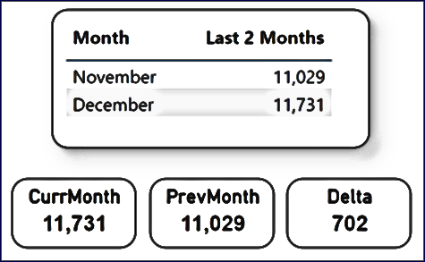

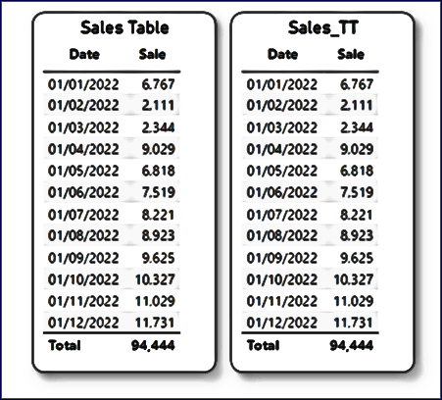


TOOL-TIP
MEASURE
MEASURE
TABLES
MEASURE
MEASURE

